Slide 1
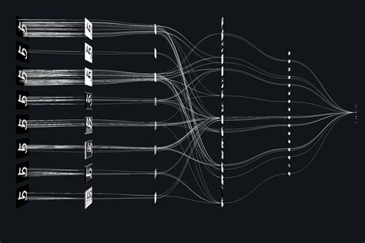
Explainable ML - XML
Pierre Gentine – Columbia University
TRANSCENDING DISCIPLINES, TRANSFORMING LIVES

Slide 2
The problem
Major advances with the deep learning
Radiation
Precipitation
Vegetation
Many (many) weights → black box
2 | XML

Slide 3
How to open up the black box?
Interpreting what is in the gut of deep NN/CNN
Explainable ML
Also helps build trustworthiness in models
→ Right answer for the right reason
A few examples:
Layerwise Relevance Propagation (LRP)
Adjoint/gradient – Saliency maps
SHAPley values
Radiation
Vegetation
3 | XML

Slide 4
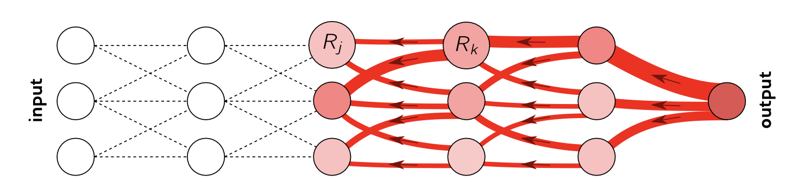
1. Layerwise Relevance Propagation (LRP)
Trying to assess where the information is coming from.
Backward – from output to input that most explain the output
Pass information/relevance backward – a la Kirchoff law (conservation of current):
Radiation
Vegetation
4 | XML
Toms et al. 2020 JAMES

Slide 5
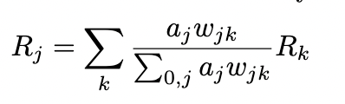
1. Layerwise Relevance Propagation (LRP)
Trying to assess where the information is coming from
Backward – from output to input that most explain the output
Pass information/relevance backward – a la Kirchoff law (conservation of current):
Layer j before layer k
a_{j} – output from layer j (after activation function) w_{jk} - weights
Radiation
Vegetation
5 | XML
Toms et al. 2020 JAMES

Slide 6
1. Layerwise Relevance Propagation (LRP)
Different LRP rules
LRP-0
LRP-epsilon Limit noisy information – filter by small noise epsilon
LRP-gamma Favor positive contributions compared to negative contributions
Equivalent to gradient x input
Vegetation
6 | XML
Montavon et al.

Slide 7
1. Layerwise Relevance Propagation (LRP)
Different LRP rules → generic rule
Can split computation into 4 substeps
What we will do in the notebook – stay tuned
Vegetation
7 | XML
Montavon et al.

Slide 8
1. Layerwise Relevance Propagation (LRP)
Radiation
Vegetation
8 | XML
Toms et al. 2020 JAMES

Slide 9
1. Layerwise Relevance Propagation (LRP)
Radiation
Vegetation
9 | XML

Slide 10
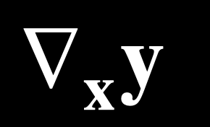
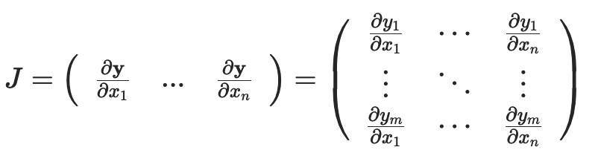
2. Gradient/adjoint
Gradient/adjoint of output y to inputs x
Radiation
Vegetation
10 | XML

Slide 11
2. Gradient/adjoint
Gradient/adjoint of output y to inputs x
Once upon a time: backpropagation Chain’s rule
Same thing!
Radiation
Vegetation
11 | XML

Slide 12
2. Gradient/adjoint
Personal experience:
Non-linear so average over different samples
Use non-dimensional/normalized inputs (and ideally outputs)
Tends to work well for first cut – but can be noisy
Radiation
Vegetation
12 | XML

Slide 13
2. Gradient/adjoint
Personal experience:
Non-linear so average over different samples
Use non-dimensional/normalized inputs (and ideally outputs)
Tends to work well for first cut – but can be noisy
Radiation
Vegetation
13 | XML

Slide 14
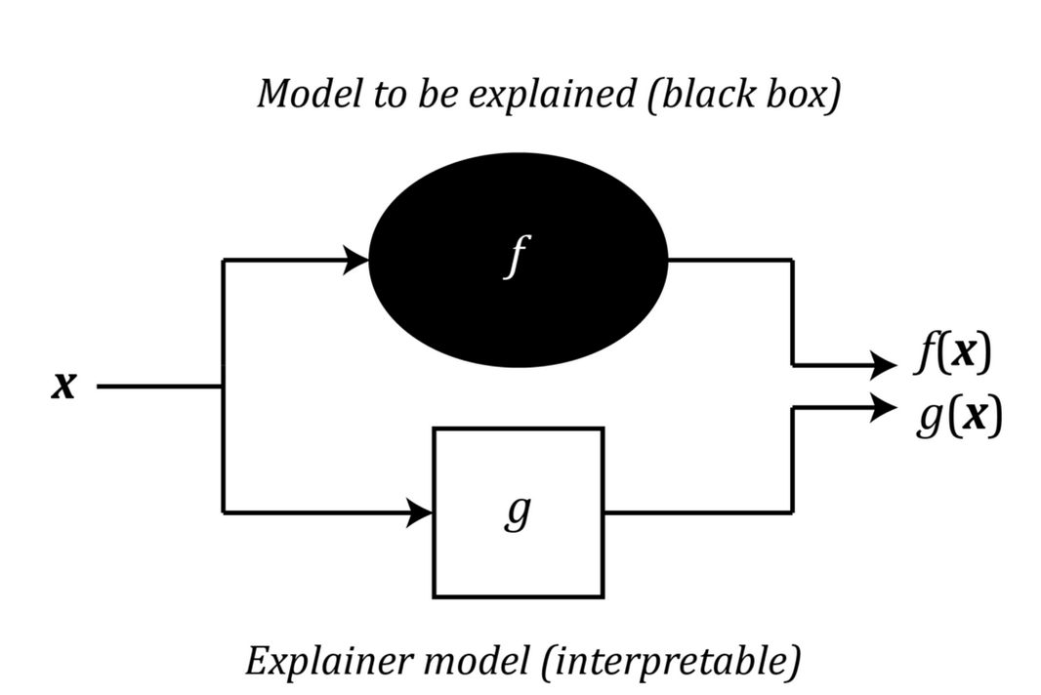
3. Shapley Additive Explanations (SHAP) values
Inspired by Game theory.
Radiation
g mimics f for a single prediction
Vegetation
14 | XML

Slide 15
3. Shapley Additive Explanations (SHAP) values
Inspired by Game theory
Lloyd Shapley (Nobel in Economics)
If we have a coalition C that collaborate to produce a value V
How much did each individual member contribute to the final value?
Radiation
Vegetation
15 | XML

Slide 16
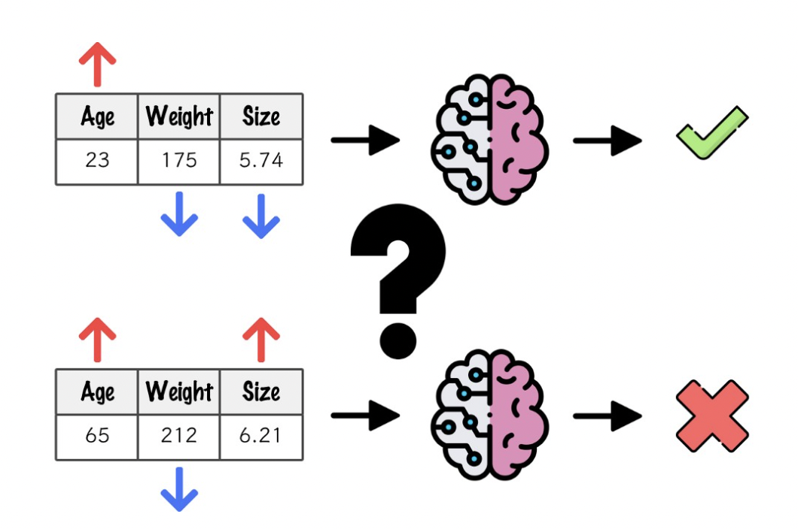
3. SHAP values
Inspired by Game theory.
Radiation
Vegetation
16 | XML

Slide 17
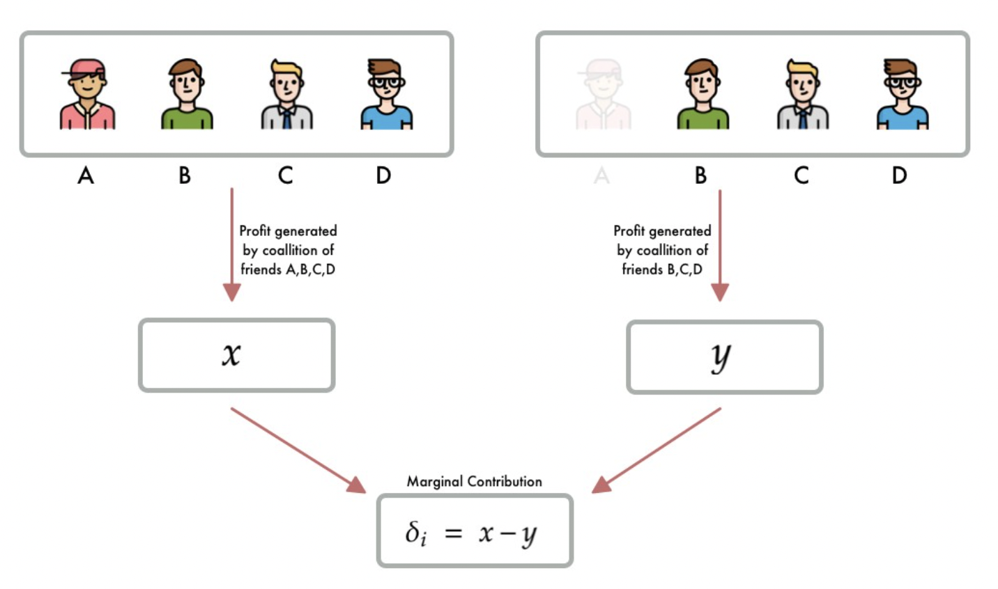
3. SHAP values
Marginal contribution of member A Coalition: subset of features (players)
Radiation
Vegetation
17 | XML

Slide 18
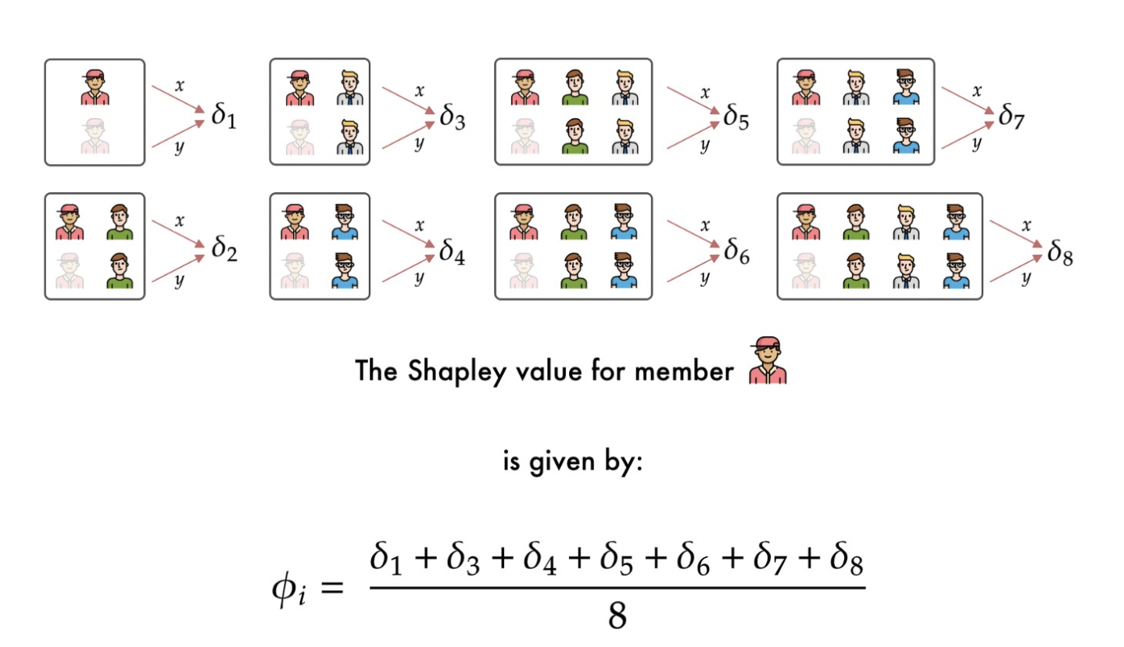
3. SHAP values
Marginal contribution of member A
Radiation
Vegetation
18 | XML

Slide 19
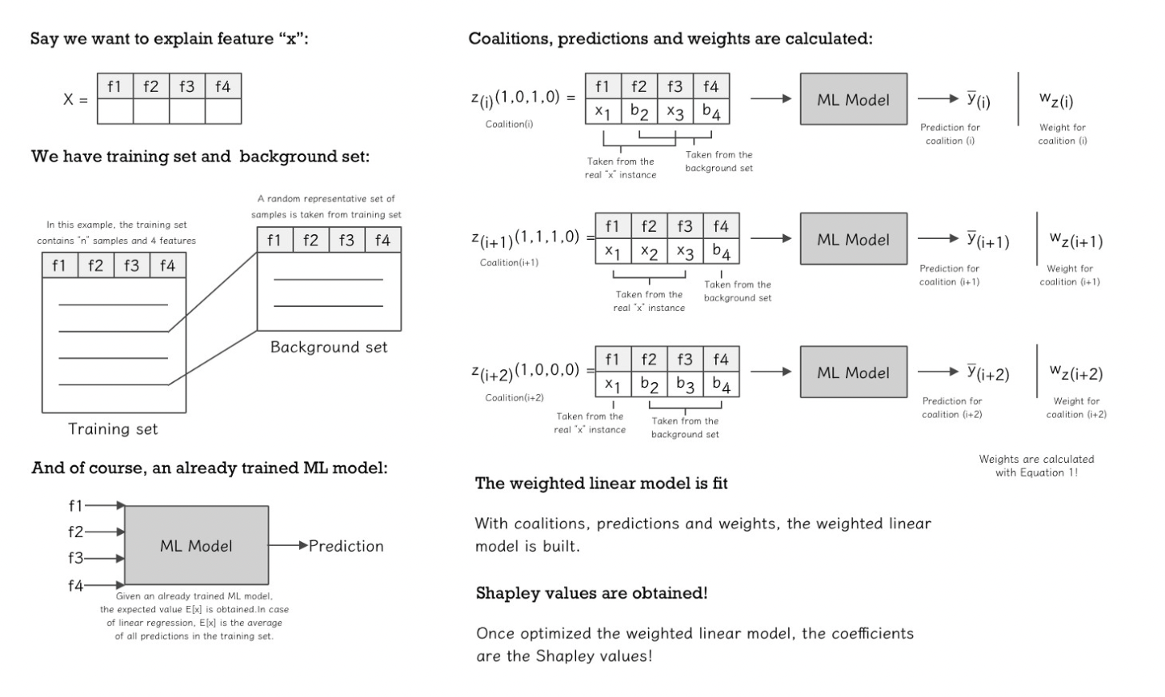
3. SHAP values
Radiation
Vegetation
19 | XML

Slide 20
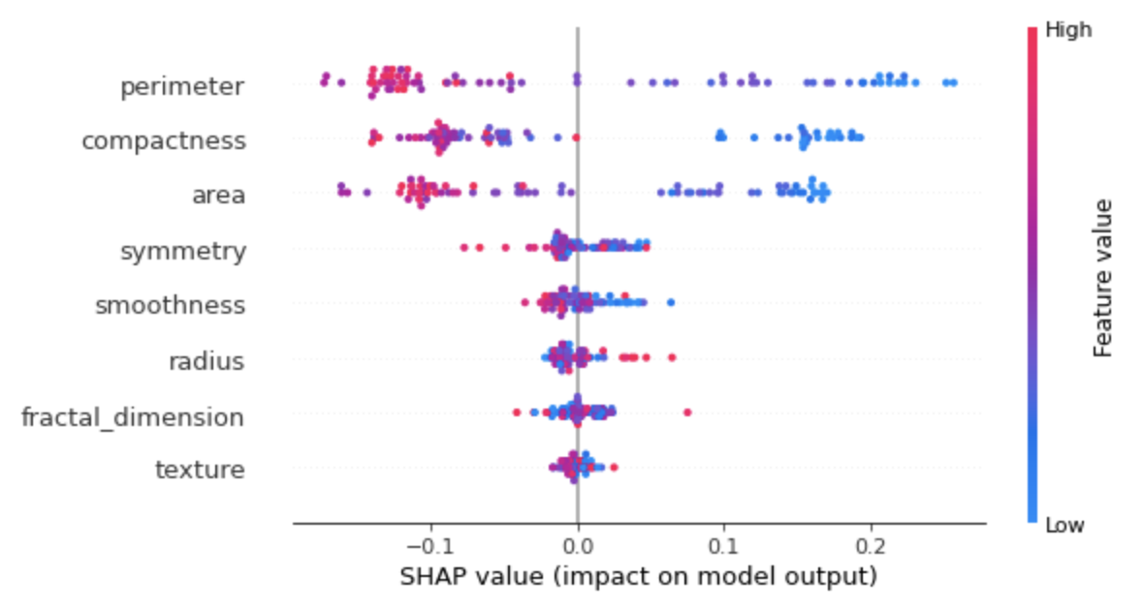
3. SHAP values
Generated results
Radiation
Vegetation
20 | XML

Slide 21
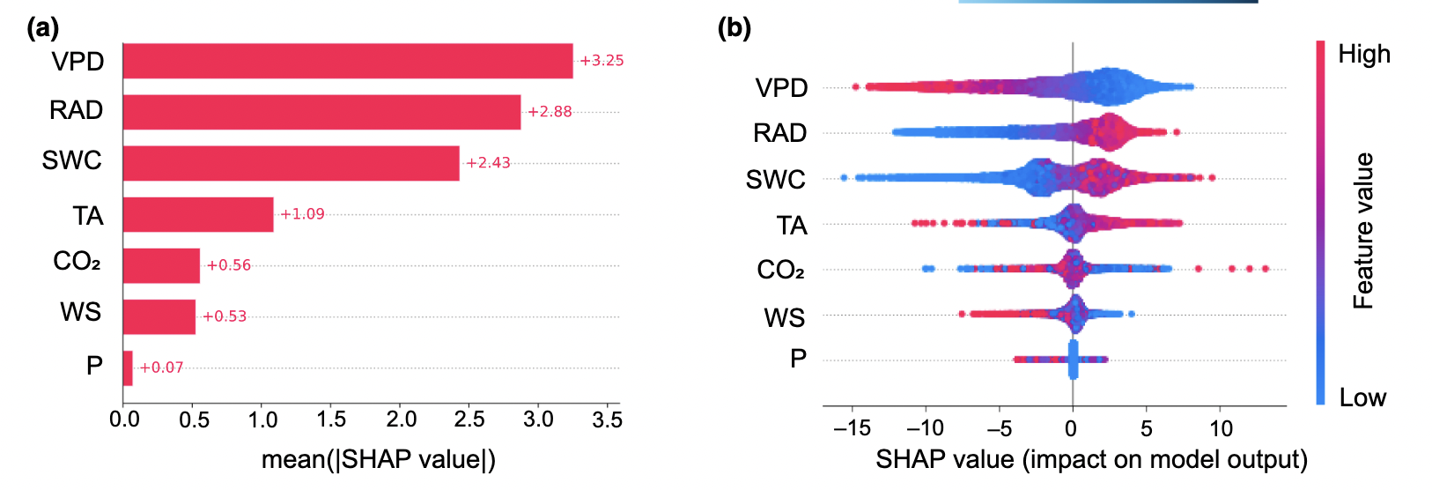
3. SHAP values
Example for continuous variables
Radiation
Vegetation
21 | XML

Slide 22
3. SHAP values
Marginal contribution of member A
Radiation
Vegetation
22 | XML

Slide 23
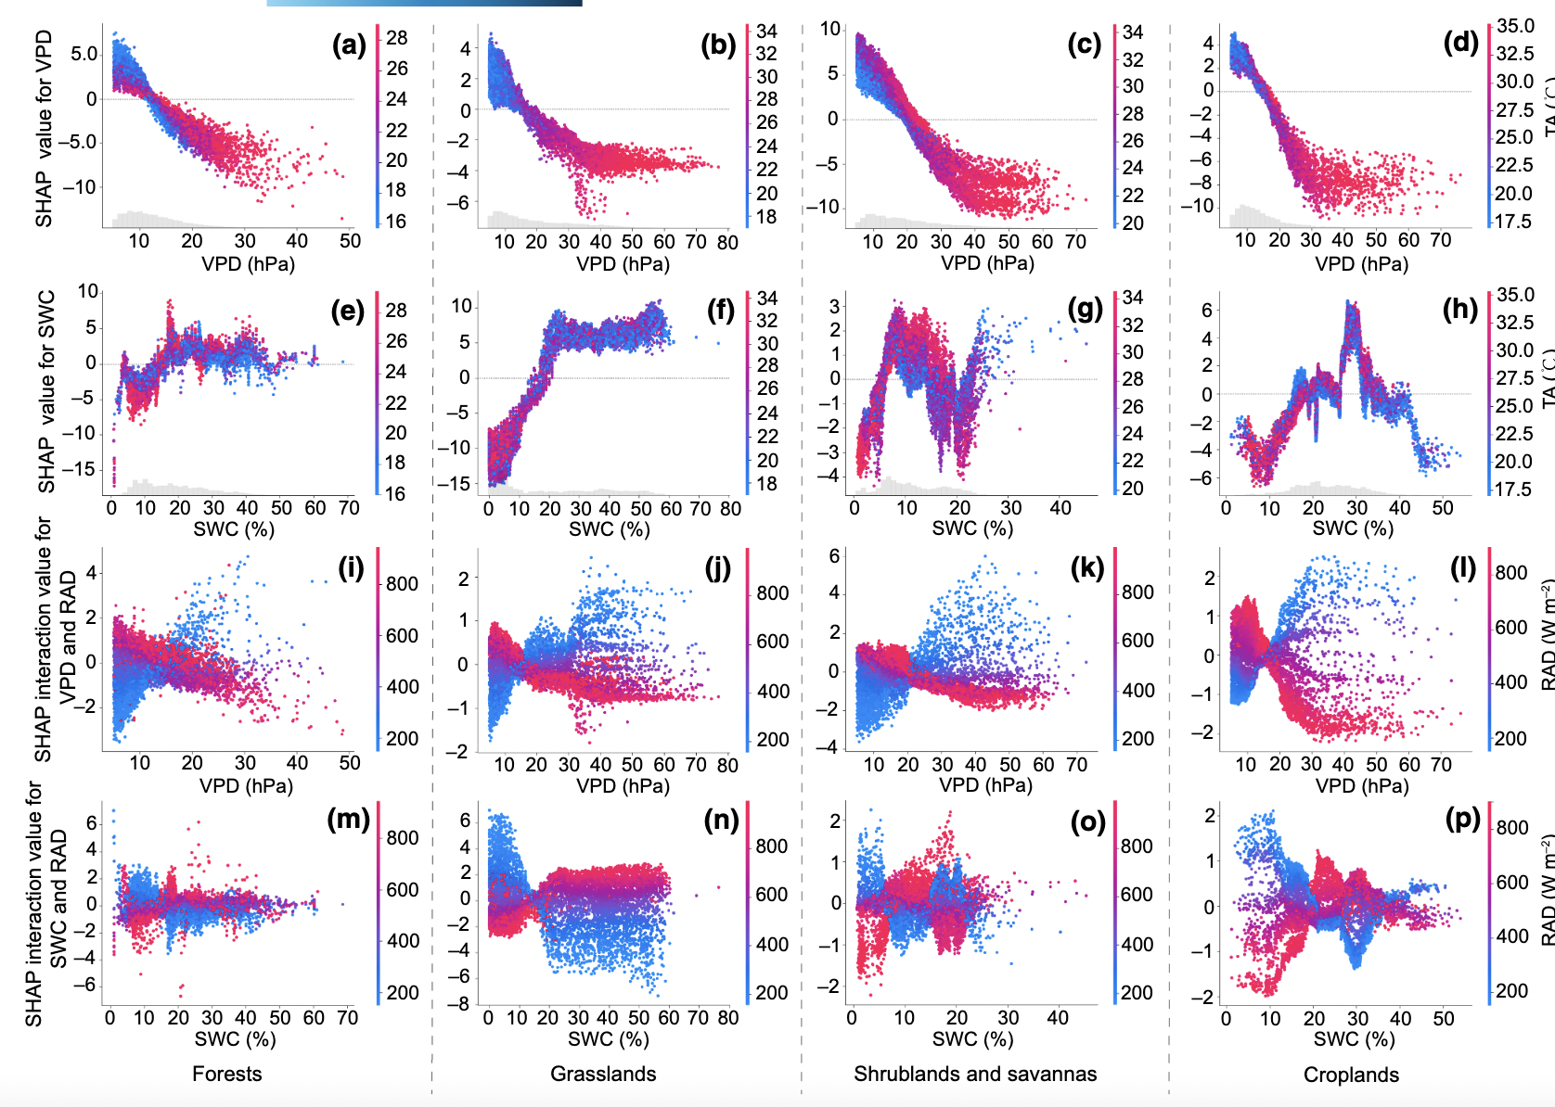
3. SHAP values
Example for continuous variables
Radiation
Vegetation
23 | XML

Slide 24
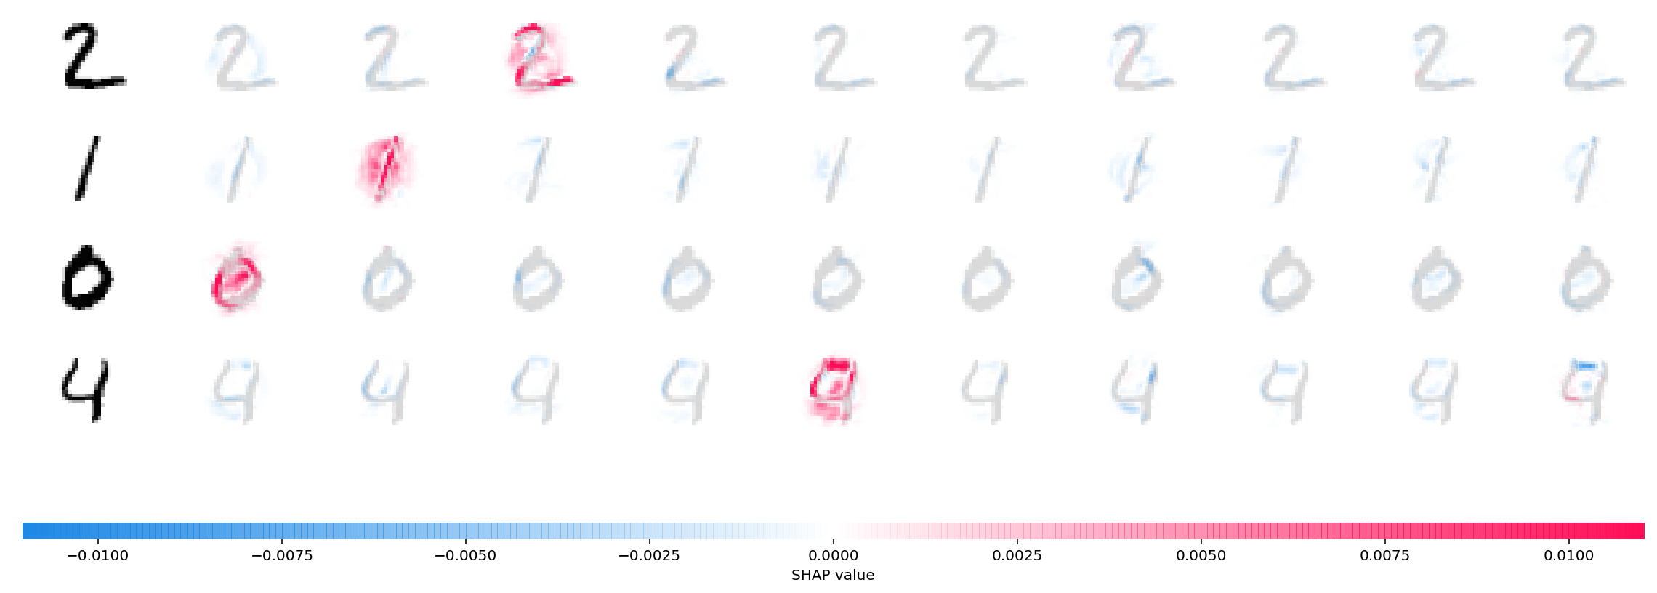
3. SHAP values
Example for images
Radiation
Vegetation
24 | XML

Slide 25
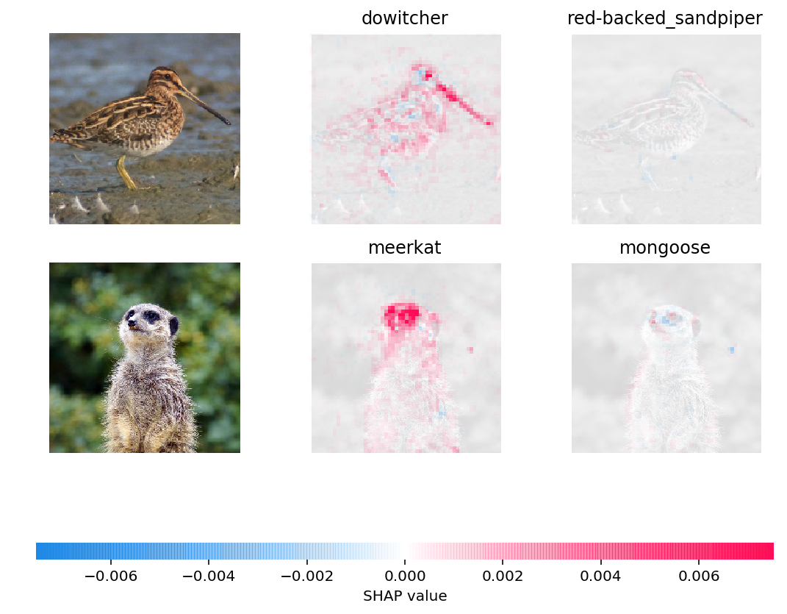
3. SHAP values
Example for images
Radiation
Vegetation
25 | XML

